Slide 1
Release Notes
Release 4.001.05
August 2, 2016

Slide 2
Table of Contents
Enhancement Slide #
Grouping Competitors / Cotenants 3
Attach Files to Locations 6
Traffic – Standard 7
Traffic – GPS Daypart 8
Map Item Labels 9
Points of Interest – Expanded Info Windows 10
Mobile Options – Mobile or Desktop Version 11
Contextual Click Changes 12
Mobile Search 13

Slide 3
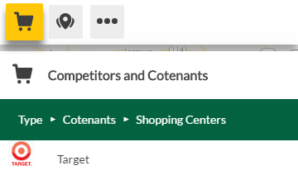
Grouping Competitors / Cotenants
Description
Allows clients to group businesses as desired into custom groups instead of having to scroll through an unfiltered list.
In this example, Target is located in the ‘Shopping Centers’ Folder

Slide 4
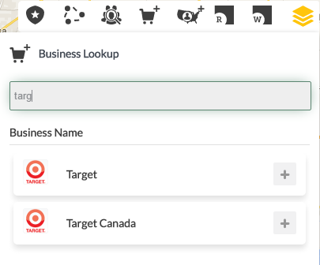
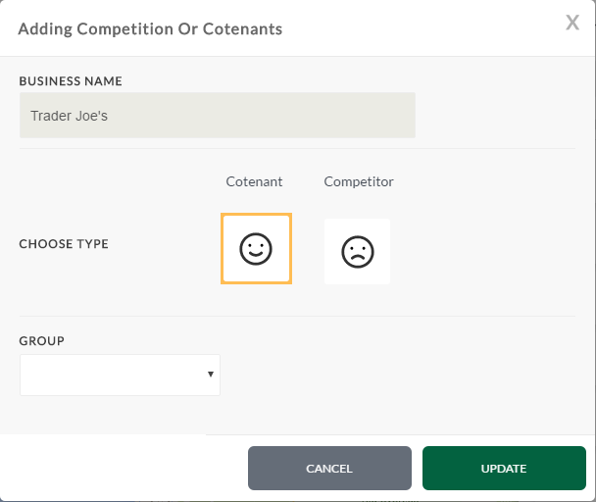
Grouping Competitors / Cotenants
How To Use
Under Buxton Data, select the businesses section and find the business you would like to group.
Select the ‘+’ icon next to the desired business to launch the grouping dialog.
Choose Competitor or Cotenant
Select the group to add it to
New groups can be created from the View Tree area (just like new Pushpin Types)

Slide 5
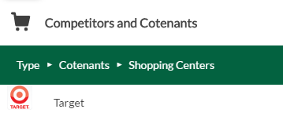
Grouping Competitors / Cotenants
How To Use
The business you choose now resides in its group, in the Competitors and Cotenants section of the view tree
Value
Groups make it faster and easier to find competitors/cotenants
Greater customization for client experience eliminating the need for the user to scroll through an unfiltered list
Difference
Locations are turned on company by company, vs group by group

Slide 6
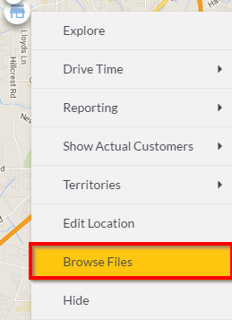

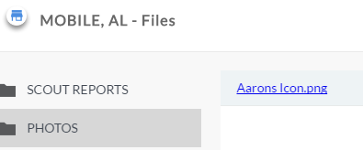
Attach Files to Locations
Description
Allows clients to attach files to stores or pushpins
How To Use
Right click on a store or pushpin
Select ‘Browse Files’
Use Manual Upload (one file at a time) or Drag & Drop (multiple files at once)
Select the desired folder
Users can then access the file from that dialog or through the file browser
Value
Allows clients to attach store specific information to individual locations
Noteworthy
We do not currently have the ability to move a client’s existing files tied to a location in SCOUT 3 to the same in SCOUT 4

Slide 7


Traffic – Standard
Description
Visualizes traffic count data
Adds the traffic info experienced in SCOUT 3 to SCOUT 4
How To Use
Go to Buxton Data / Points of Interest
Check the box for traffic counts
Will be added to all SCOUT 4 clients who do not have the enhanced GPS Traffic
Value
Insight into average daily traffic volumes

Slide 8
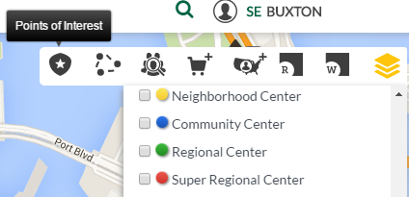
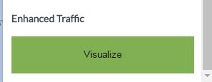
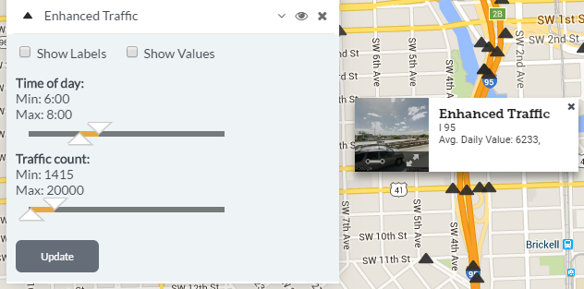
Traffic – GPS Daypart
Description
Visualizes day-part traffic count data vs average daily volumes
Visualizes traffic count data
To be loaded only to clients who have paid for this feature
How To Use
Go to Buxton Data / Points of Interest
Check the box for Traffic Counts
Select the Visualize button to filter data by time of day and / or total count
Click ‘Update’ after making changes
Value
Provides insight into traffic information at greater granularity than average daily volumes

Slide 9
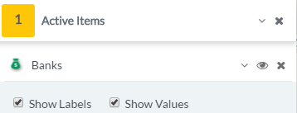
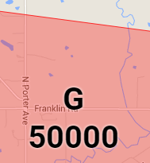

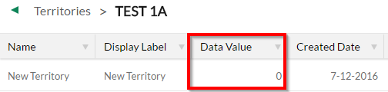
Map Item Labels
Description
Allows clients to show/hide labels and values for each type of map item
How To Use
Turn on a map item
Go to active items
Select the dropdown
Toggle the checkboxes for “Show Labels” and “Show Values”
Value
Allows client to see the data for that item without having to hover or open info windows

Slide 10

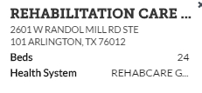



Points of Interest – Expanded Info Windows
Description
For institutions in Buxton Data that have Point of Interest information (e.g. Schools, Hospitals, Credit Unions, etc), info windows will now display
How To Use
Turn on a Point of Interest item
Left click on the icon on the map
Expand the info window to view the data (see arrow example)
Value
Provides greater insight into a location without having to run a report or go outside of the platform to get that information.
Examples:

Slide 11
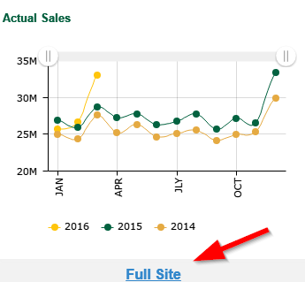
Mobile Options – Mobile or Desktop Version
Description
Mobile users are now able to select a link to navigate to the desktop site on a mobile device
While the optimal SCOUT experience is on a desktop, tablet users on the go will benefit from this ability (not available for the dashboard or My Data)
How To Use
From the mobile site, select the “Full Site” link at the bottom of the main page. This will redirect you to the desktop SCOUT site.
Value
Allows clients on the go to utilize the full SCOUT site.

Slide 12
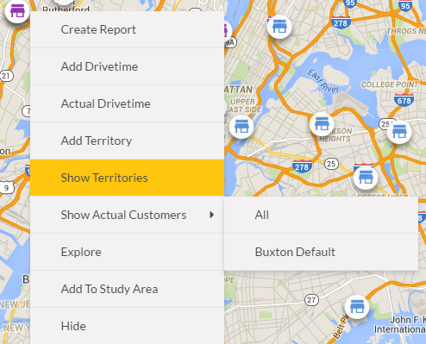
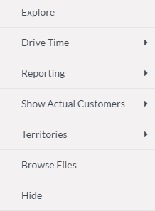
Contextual Click Changes
Description
Adding organization to the contextual click to keep it short and easy to use
How To Use
Same usage as before – right click points, geographies, or free space on the map
Value
Allow for more options while keeping the contextual menu concise
Before
After

Slide 13
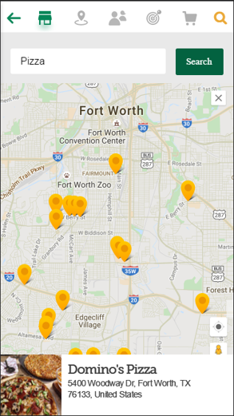
Mobile Search Enhancement
Description
Mobile search for businesses has been enhanced to return the top 25 businesses instead of only one return.
Individual addresses can still be searched for.
How To Use
Same as before – search for a business by type (e.g. “Pizza”, “BBQ”, etc).
Value
Allows for clients to more easily toggle through search results instead of having to be very specific with their search term.

Slide 14

Moving Pushpins
Description
Previously, pushpins could be moved too easily or even accidentally just by clicking and dragging them.
How To Use
Left click and hold on the pushpin, for a second, and a loading bar will appear on top of the pushpin.
Once the loading bar is complete, the pushpin will begin to ‘bounce’ up and down indicating that it’s ready to move.
Click the pushpin again and move as desired, release when finished.
Value
Eliminates ‘accidentally’ moving pushpins.

Slide 15

Notable Bug fixes
Fixed
Session logout time is now 8 hours across the Platform
Info Windows now account for long location names
Contextual Click now accounts for long names (e.g. long customer type names)

